Slide 1
Sales Volume Forecasting

Slide 2
*Client: Product distributor who purchases office products from manufacturers, holds them and then resells them to its business customers *Improve the inventory planning process for the product distributor *Create a model that makes predictions about the sales volume for different product categories
Background

Slide 3
Value of model
*Meet customer demand and ensure customer satisfaction
*Avoid having too much inventory which can lead to unnecessary storage and handling costs
*Avoid stockouts which can result in sales loss
*Maintain high profitability

Slide 4
Target Audience
*Product distributor whose data was analyzed
*All product sales planning, supply chain, and procurement professionals

Slide 5
Data Source
*The data used for this project comes in the form of CSV files obtained from the product distributor.
*The CSVs have 5-years worth of data (2018 to 2022) for Purchase, Sales and Product Details.

Slide 6
Data Hosting

Slide 7
Data Cleaning
01
02
03
04
Load and merge DataFrames
Select and filter the columns to be used
Convert the columns to the appropriate data type
Group the data to get yearly and monthly aggregates

Slide 8
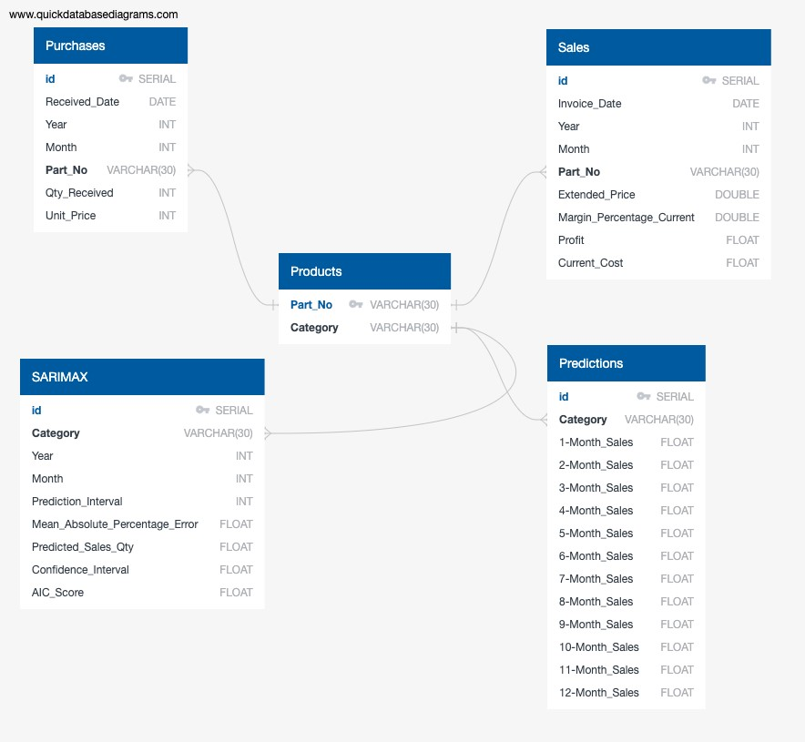
Database Creation

Slide 9
Data Model Description
SARIMAX Model

Slide 10
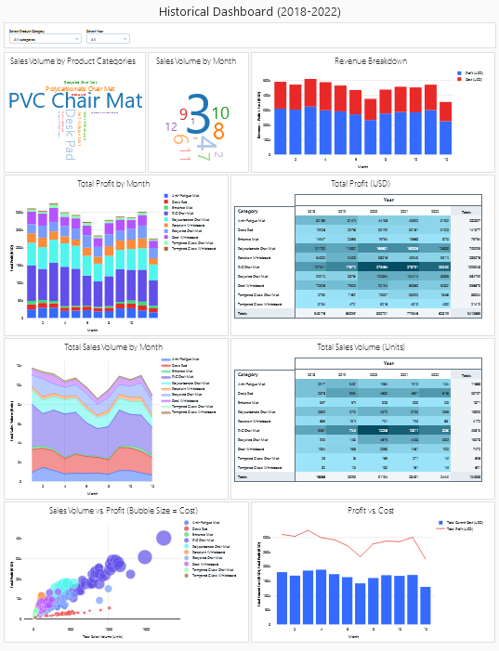
Visualizations and Dashboard

Slide 11
Limitations and Assumptions
01
02
03
04
134 different product SKUs within the original dataset
Unlimited resources and budget
Unlimited warehouse space to store the products
No minimum order quantities

Slide 12
Challenges
*ETL was processed in Databricks and it was truncating the data to 10,000 rows.
*The dashboards in Databricks do not have a default option for adding filters to visualizations.
*The filters on the Databricks dashboards do not carry over to the HTML file

Slide 13
Conclusions
*

Slide 14
Thank you for listening!

Slide 15
Any Questions?

